Slide 1
FULLY OPEN SOURCE DATA DASHBOARDS WITH R
bit.ly/rss-2022_cjh
Charlotte Hadley
@charliejhadley

Slide 2




Quarto
{htmlwidgets}
{shiny}

Slide 3

Quarto
Quarto allows us to build:
Interactive reports and slides
Static reports and slides (PDF, MS Word and PowerPoint)
Entire websites
Quarto allows us to build using either of these languages:
R
Python
Julia

Slide 4
Quarto
Quarto allows us to build:
Interactive reports and slides
Static reports and slides (PDF, MS Word and PowerPoint)
Entire websites
Quarto allows us to build using either of these languages:
R
Python
Julia
Quarto is the next evolution of RMarkdown

Slide 5
Quarto
{htmlwidgets}
{shiny}

Slide 6
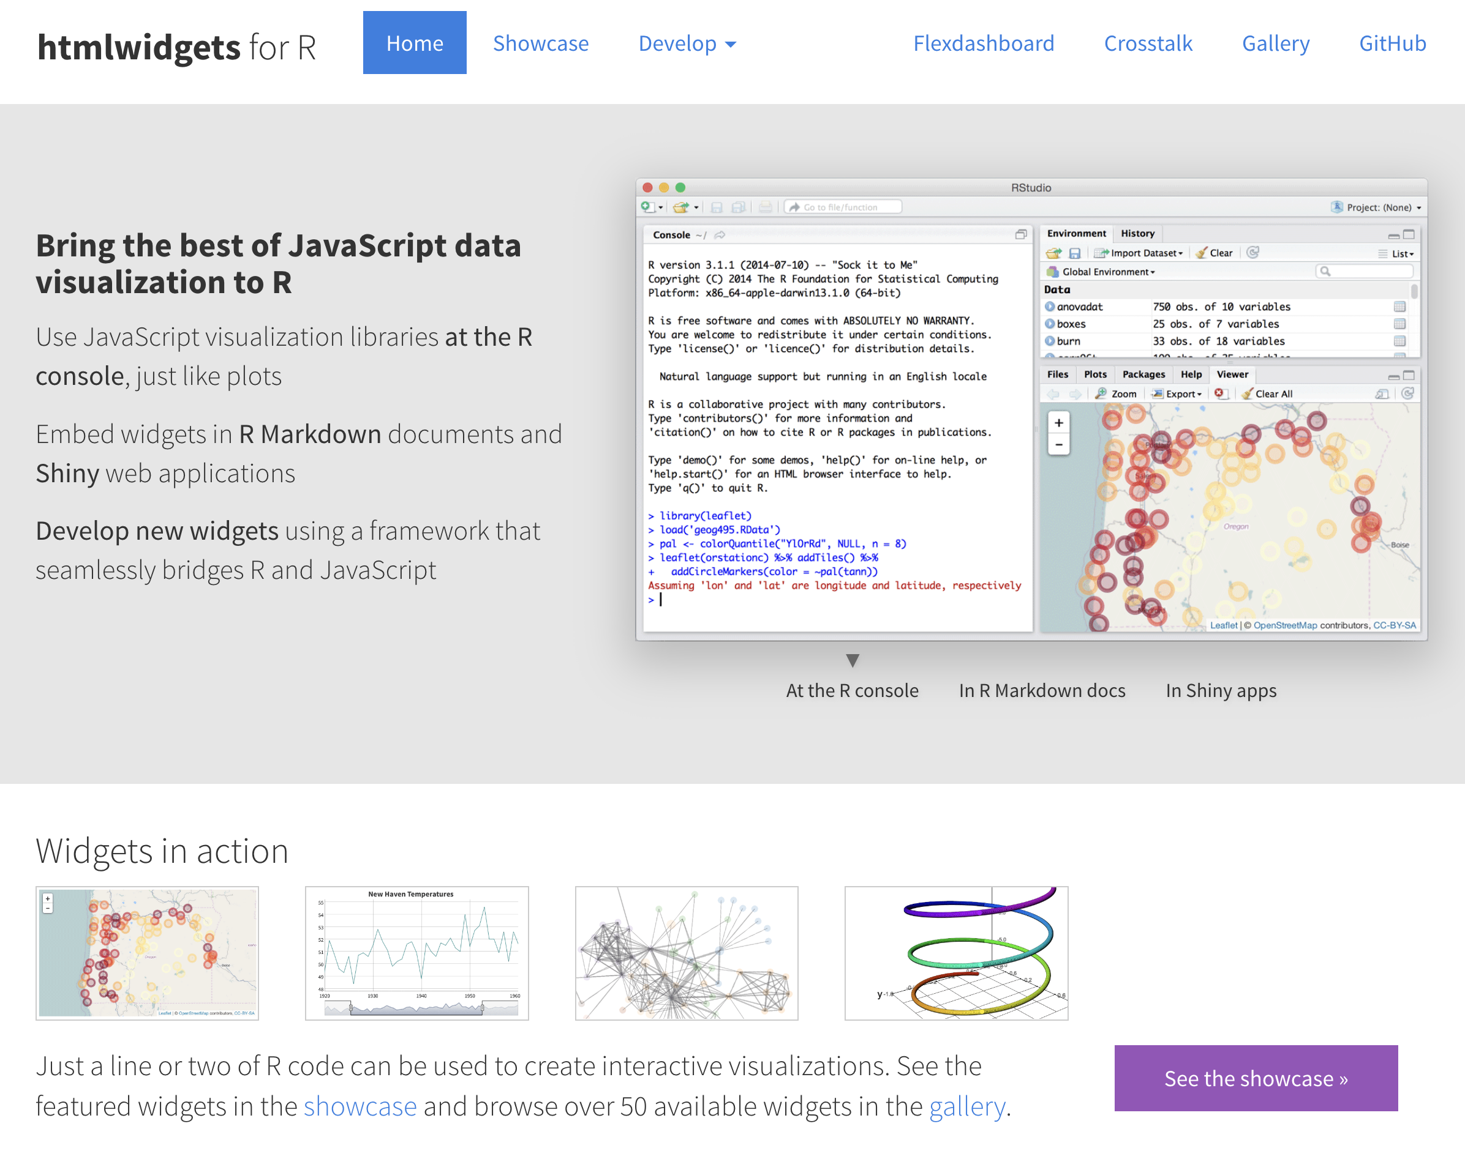

Slide 7
Quarto
{htmlwidgets}
{shiny}
Doesn’t require a server – everything happens in the browser

Slide 8

Quarto
{htmlwidgets}
{shiny}
Needs a server

Slide 9
{shiny} for R
{shiny} is a fully self-contained framework for building web apps dashboards with R.
We write the UX with R code.
We write the server side of the code with R.

Slide 10
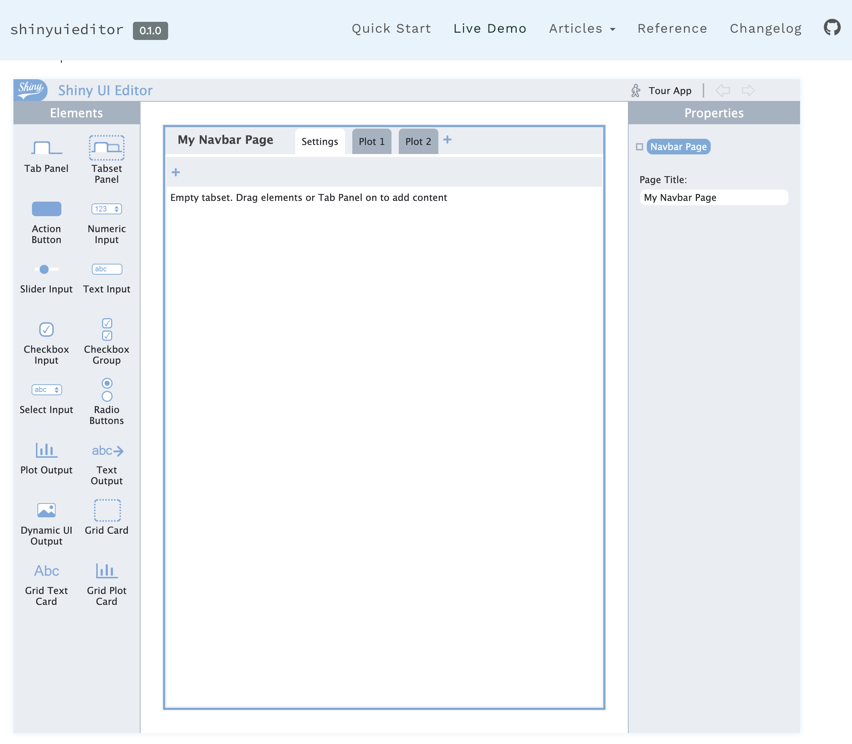
A beta tool for building {shiny} GUI

Slide 11


Commercially licensed CMS for Shiny apps
Hosted for you
Self-hosted

Slide 12

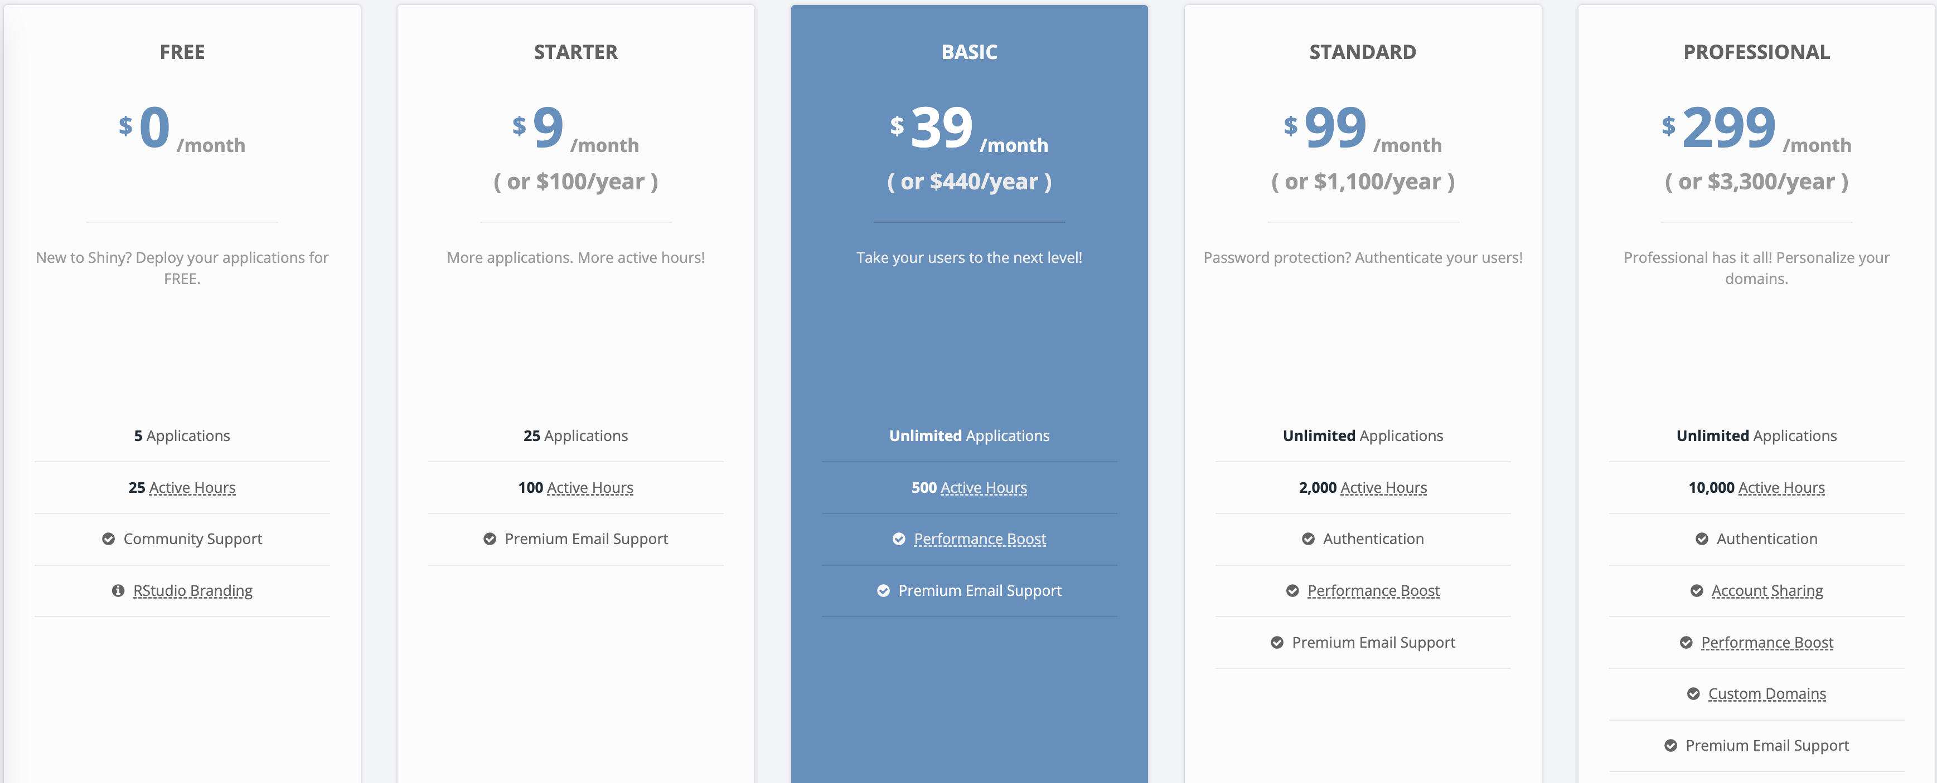

Slide 13
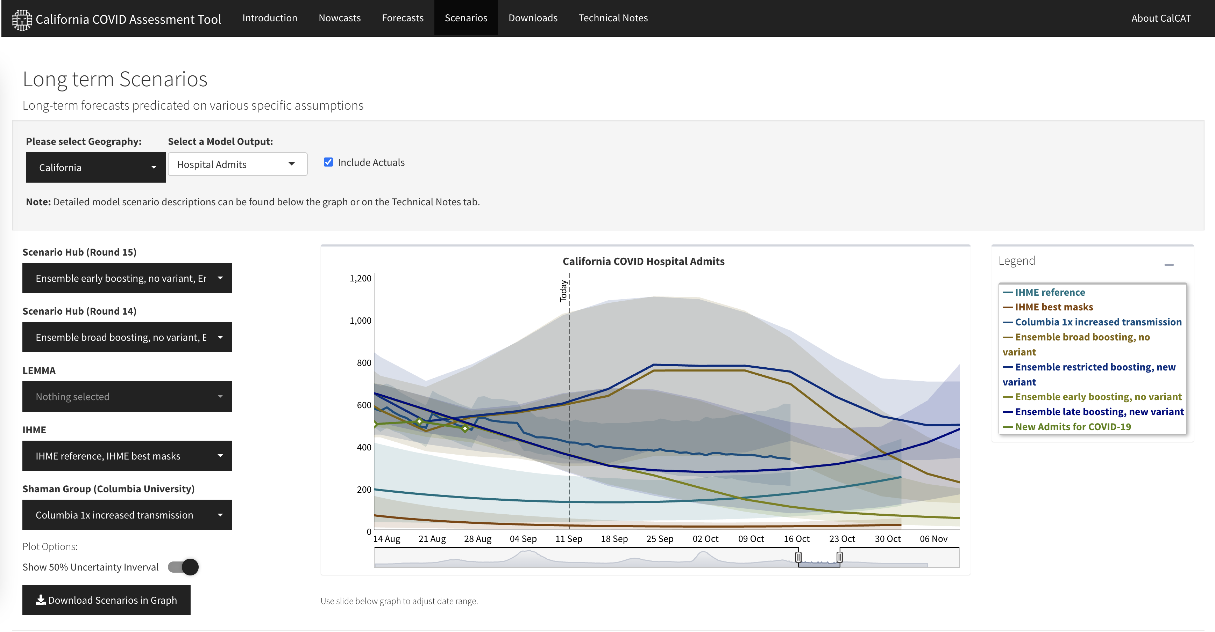
{shiny} in production

Slide 14
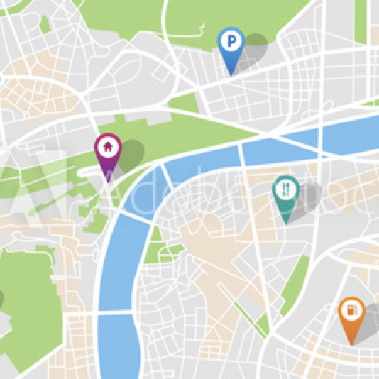
Features for shiny apps
Manage user access to shiny apps
Manage admin rights to shiny apps
Manage server resources

Slide 15
Features for shiny apps
Manage user access to shiny apps
Manage admin rights to shiny apps
Manage server resources
For RMarkdown & Quarto aps
Manage access to shiny apps
Programmatically run reports by schedule or a trigger

Slide 16

Features for shiny apps
Manage user access to shiny apps
Manage admin rights to shiny apps
Manage server resources
For RMarkdown & Quarto aps
Manage access to shiny apps
Programmatically run reports by schedule or a trigger
For hosting R API
Create from R code using {plumber}

Slide 17
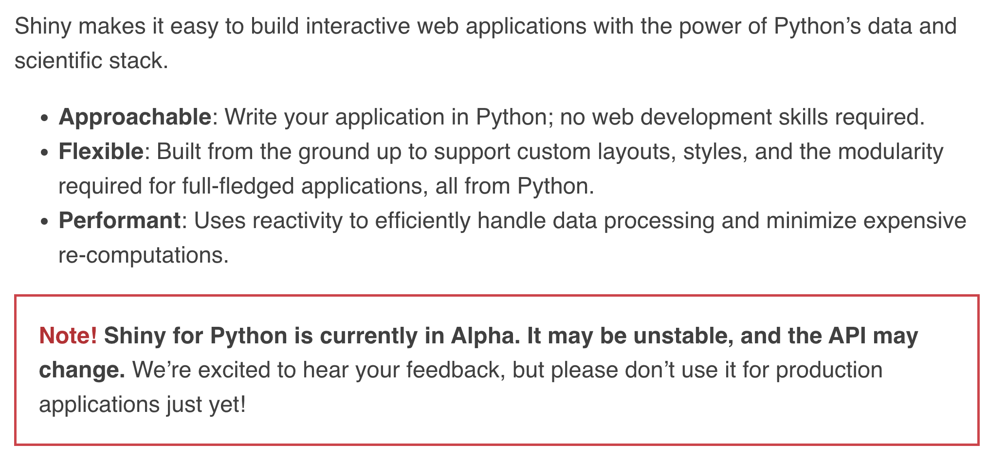
shiny for Python!
shiny.rstudio.com/py

Slide 18
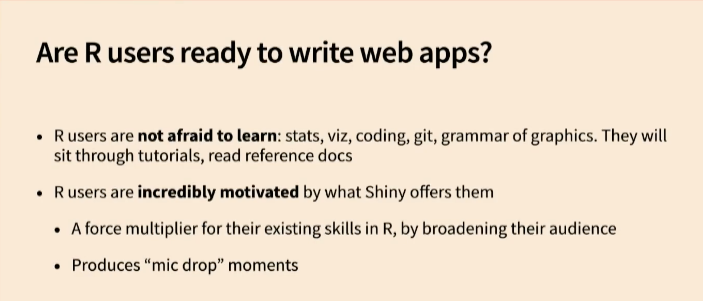

rstudio::conf(2022)
The Past and Future of Shiny
Joe Cheng
rstudio.com/conference/2022/keynotes/past-future-shiny

